Slide 1
PROFOUND MEDICAL CORP.
Pioneering a new standard of care in the treatment of prostate cancer

Slide 2
Forward-Looking Statements
This presentation and oral statements made during this meeting regarding Profound and its business which may include, but are not limited to, the expectations regarding the efficacy of Profound’s technology in the treatment of prostate cancer. Often, but not always, forward-looking statements can be identified by the use of words such as "plans", "is expected", "expects", "scheduled", "intends", "contemplates", "anticipates", "believes", "proposes" or variations (including negative variations) of such words and phrases, or state that certain actions, events or results "may", "could", "would", "might" or "will" be taken, occur or be achieved. Such statements are based on the current expectations of the management of each entity. The forward-looking events and circumstances discussed in this presentation may not occur by certain specified dates or at all and could differ materially as a result of known and unknown risk factors and uncertainties affecting the company, including risks regarding the pharmaceutical industry, economic factors, the equity markets generally and risks associated with growth and competition.
Although Profound has attempted to identify important factors that could cause actual actions, events or results to differ materially from those described in forward-looking statements, there may be other factors that cause actions, events or results to differ from those anticipated, estimated or intended. No forward-looking statement can be guaranteed. Except as required by applicable securities laws, forward-looking statements speak only as of the date on which they are made and Profound undertakes no obligation to publicly update or revise any forward-looking statement, whether as a result of new information, future events, or otherwise, other than as required by law.

Slide 3
Investment Highlights
Commercializing a new, minimally invasive technology (TULSA) for the ablation of targeted prostate tissue
Received CE Mark approval in April 2016 for TULSA-PROTM
Large and growing market opportunity; significant unmet medical need
Strong IP portfolio
Attractive razor/razor blade revenue model
MRI installed base with strong partnerships
Near- and mid-term milestones offer value inflection opportunities

Slide 4
Prostate Cancer Incidence
1 in 7 men will be diagnosed with prostate cancer in their lifetime
American Cancer Society, www.cancer.org

Slide 5
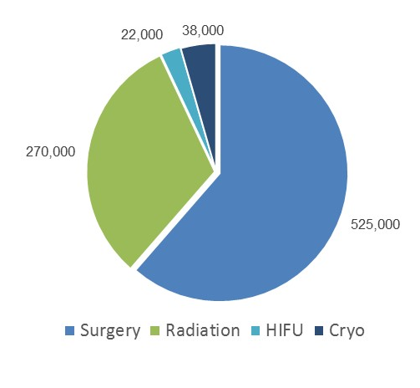
Large & Growing Market
# of Procedures (EU & US)
500,000 new patients per year
850,000 procedures per year
US$40 Billion Market
Surgery $18B
Radiation $20B
HIFU $0.9B
Cryo $0.7B
iData Research 2012
US and European Urological Market Reports

Slide 6
The Problem
While prostate cancer survival rates are high, the current therapies have undesirable complication rates
15% Surgery
25% Radiation
80% Surgery
Potosky et al, “Five-year outcomes after prostatectomy or radiotherapy for prostate cancer: the Prostate Cancer Outcomes Study (PCOS),” Journal of the National Cancer Institute, 96(18): 1358-1367 (2004)

Slide 7

What If?
What if you could treat localized prostate cancer in 2 hours?
Minimally invasively
With real-time image guidance
In a single treatment
With the same or even better outcomes than surgery or radiation

Slide 8
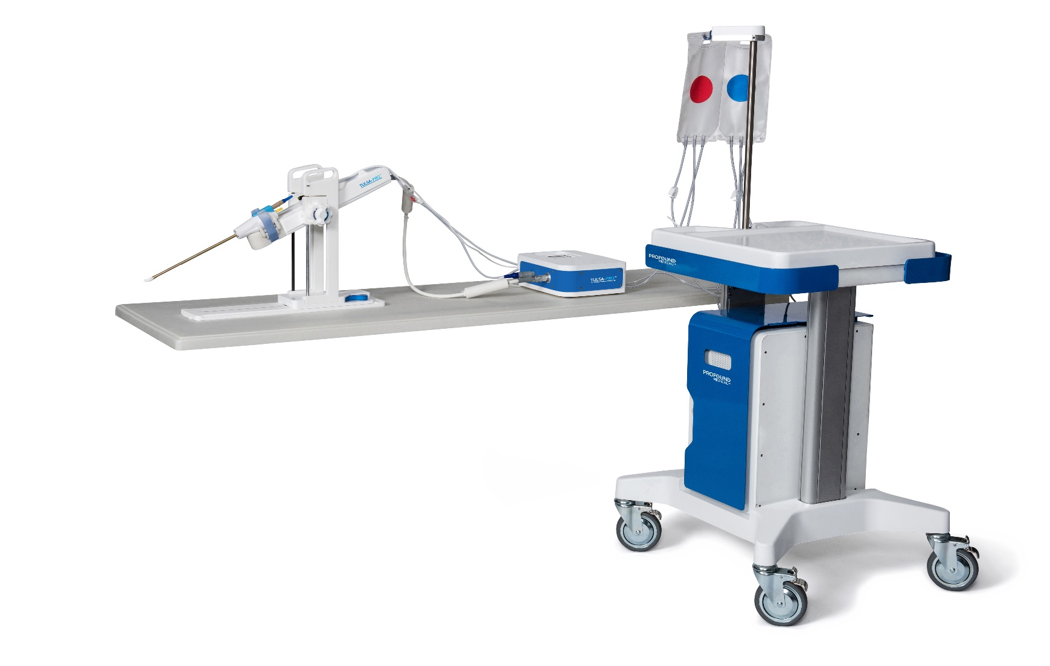

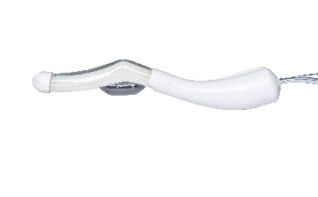
Our Solution
3
4
5
1
2
6
Ultrasound Applicator
Endorectal Cooling Device
Positioning System
Positioning System Interface Box
System Cart
System Electronics
Disposables
Capital Equipment

Slide 9
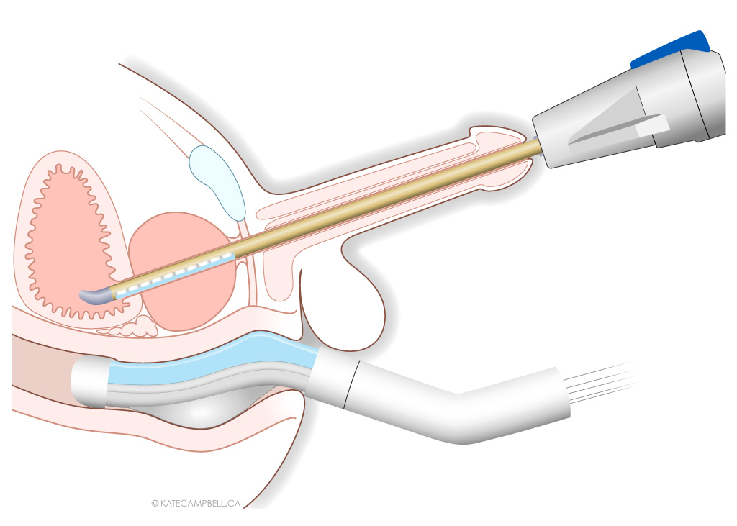
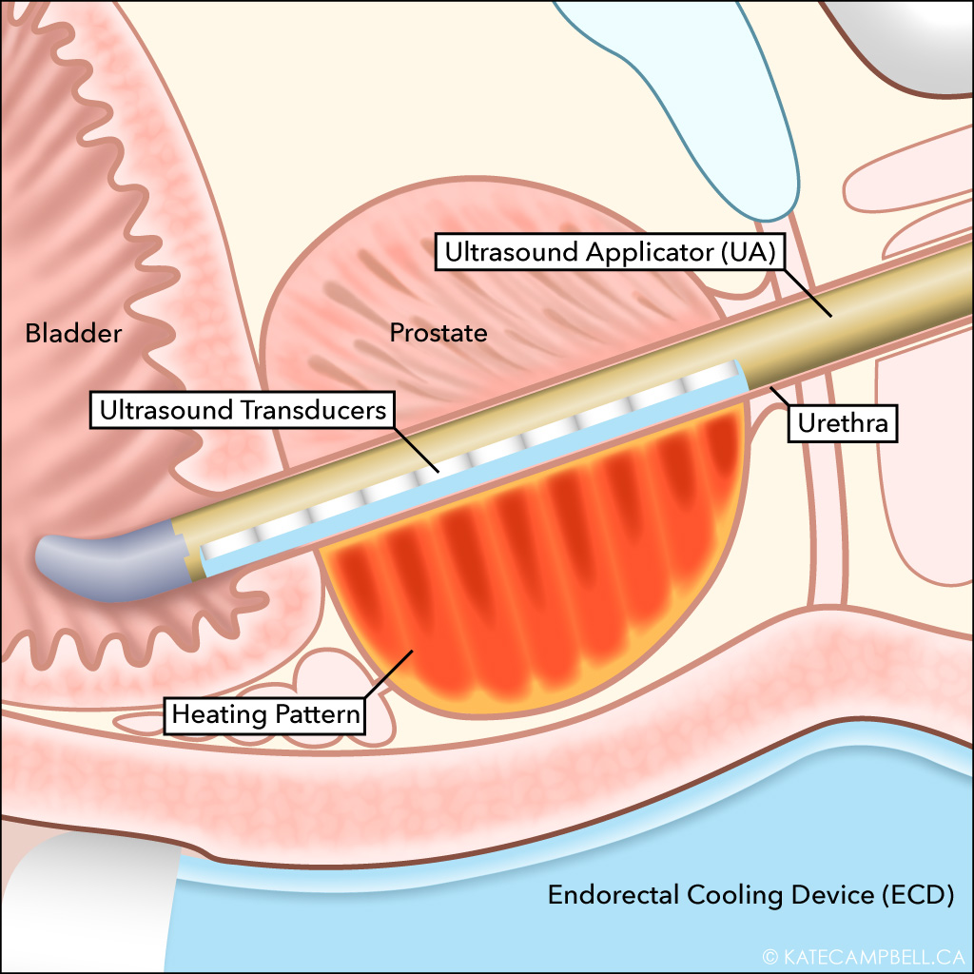
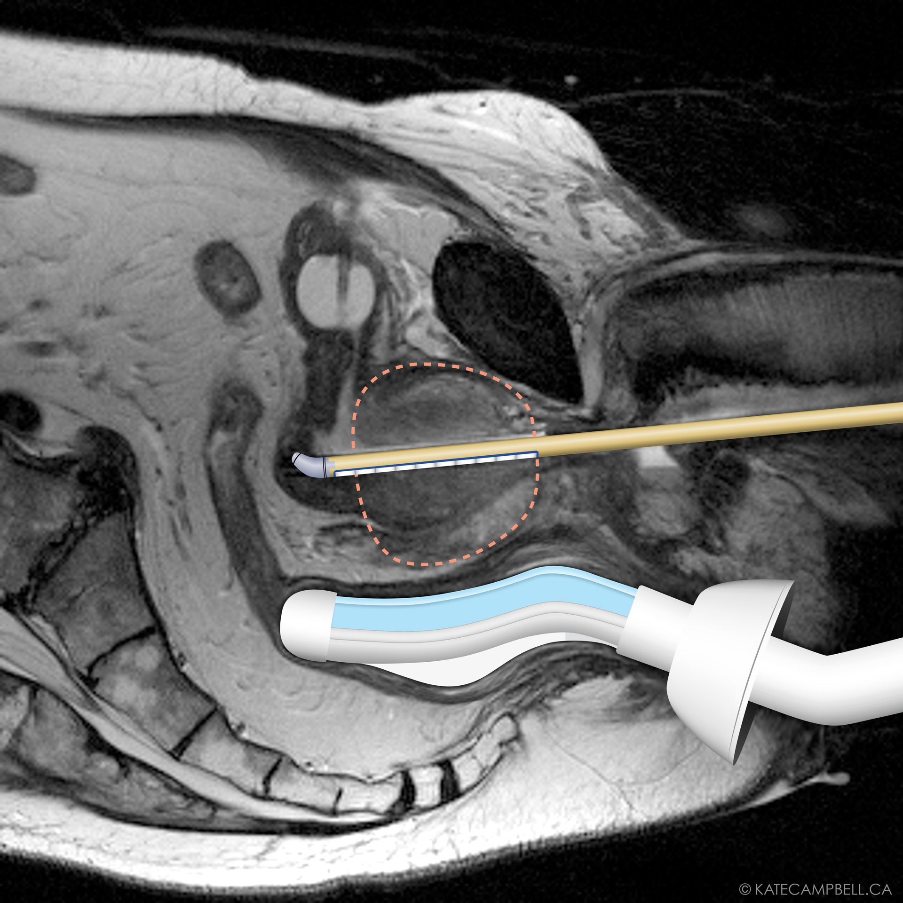
Our Solution

Slide 10
TULSA-PRO Procedure
The Procedure
Click here to view Animation

Slide 11
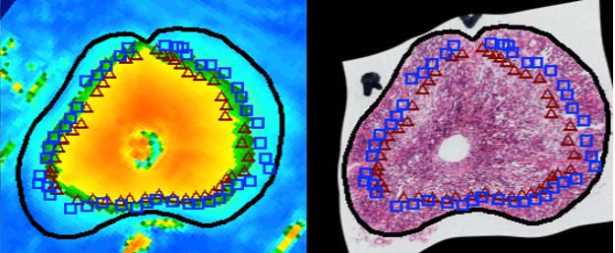
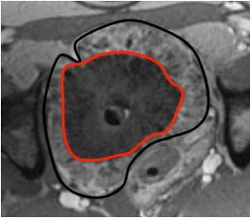
Proven Accuracy
Testing in prostates showed excellent agreement between MRI temperature measurements, histology and contrast-enhanced MRI
MR Thermometry
Histology
Contrast-enhanced MRI
0% cell kill
all tissues outside are normal
100% cell kill
all tissues inside are killed
Prostate region of non-perfusion
Chopra et al, Phys Med Biol. 2009; 54(9): 2615-33

Slide 12
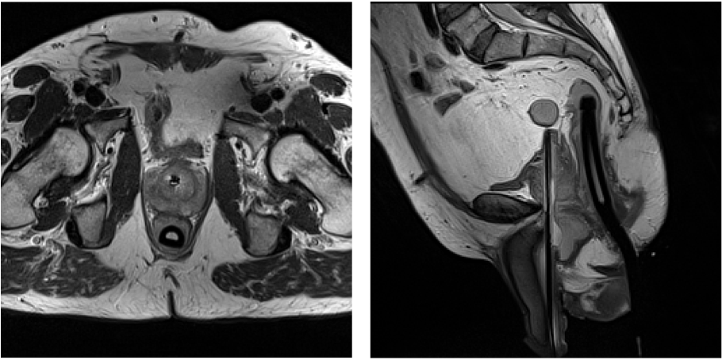
Reduced Tissue Damage
Our preclinical study observed 83% of urethral tissue was preserved after treatment
Inside-Out
Outside-In
UA

Slide 13
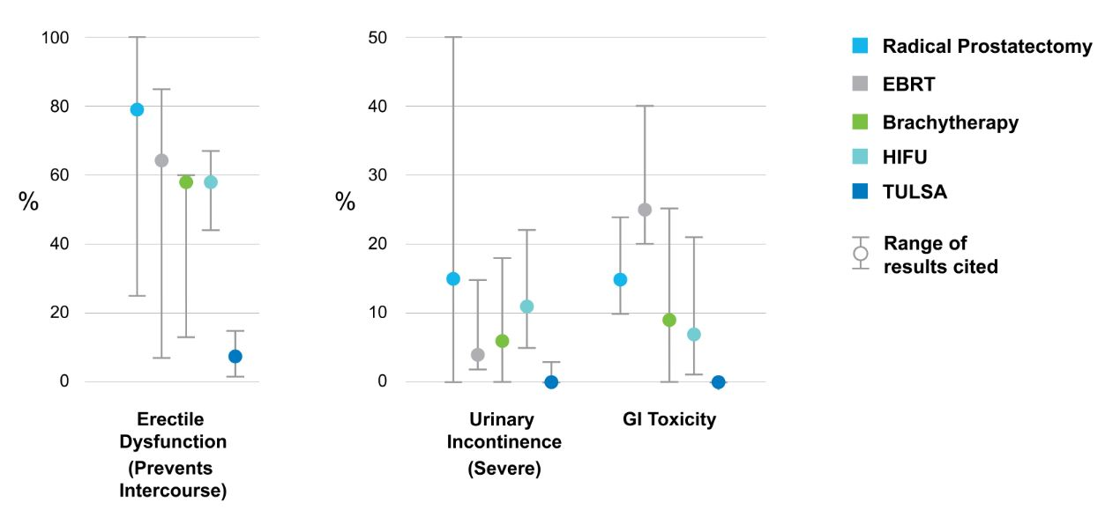
Lower Complication Rates
Profound’s technology results in fewer significant complications
*Thompson (Chair) et al for AUA Prostate Cancer Clinical Guideline Update Panel (2007) Guideline for the management of clinically localized prostate cancer: 2007 update. The Journal of Urology 177(6): 2106-31
*PMI 12-month Phase 1 Trial, GCP-10102 Table 10.

Slide 14
Phase I Clinical Trial – 12-month data
The Phase I trial has demonstrated that MRI-guided TULSA provides accurate treatment planning, real-time thermal dosimetry and precise control of prostate ablation to within 1.3 mm, with a well-tolerated side-effect profile.
Outcomes:
30 patients treated with at least 12 month follow-up
No intraoperative complications, no rectal injury or fistula
Erectile dysfunction rate of 8% (IIEF item 2 ≥ 2)
At 12 months, only 1 patient (3%) with Grade 1 urinary incontinence (no pads)
Functional quality-of-life outcomes back to baseline levels

Slide 15
Current Therapies
Current techniques may damage tissue far outside the therapy target area, or risk damage to critical structures
Radiation
Non-invasive
Outside-In
Risk associated with treatment of surrounding tissue
High rate of side effects, including damage to bowel
HIFU
Non-invasive
Outside-In (Trans-rectal)
High rate of side effects, including thermal damage to bowel
Limited to average or smaller size prostates
Radical Prostatectomy
Invasive surgical technique
Removes the gland and related tissues
High rates of side effects such as incontinence and impotency
Success related to skill of surgeon
Non-invasive
Inside-Out
(Trans-urethral)
Precisely treats prostate tissue with minimal damage to nearby critical structures
Low rate of complications

Slide 16
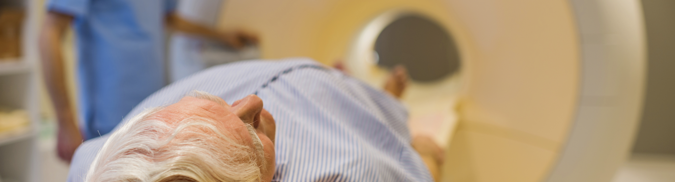
Advantages
Safe, fast and accurate
Millimeter accuracy ablates cancerous tissue while sparing critical structures
Quick procedure with single treatment and rapid recovery time
Minimally-invasive using thermal ablation to heat prostate from inside-out
Guided by real-time MR imaging with temperature (thermometry) feedback
Technology compatible with leading MRI platforms

Slide 17
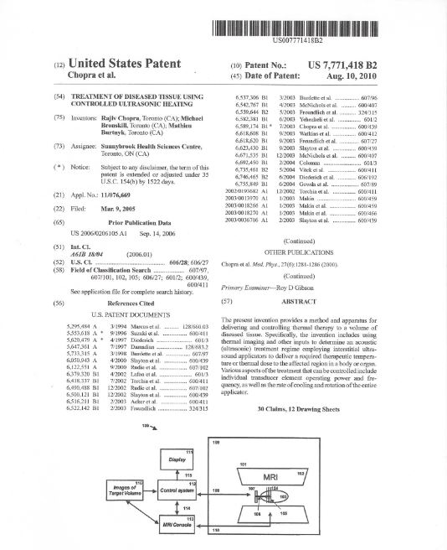
Opportunity is Well Protected
Strong IP Portfolio:
6 patents issued in the United States
6 patents pending in the United States
9 patents pending foreign applications

Slide 18




Strong Market Access Through Key Partnerships
Joint Development Agreement announced July 2015 to support TULSA technology on Philips' Ingenia and Achieva 3T MRI systems; Sales and Marketing Agreement announced May 2016 to advance TULSA-PRO commercial launch
Strategic Collaboration Agreement announced March 2016 to co-market and co-sell into the Siemens installed base of customers; each partner will invest $2 million in marketing, educational and sales activities
Based on early discussions with GE, we have initiated validation testing of TULSA-PRO with GE 3T MRI Systems

Slide 19
Strong Leadership
Executive Team
Steven Plymale | CEO (Xltek, CryoCath, Cedara, Claron, Bluehaven)
Ron Kurtz | VP, Engineering (Xltek)
Goldy Singh | VP, Quality & Regulatory Affairs (Xltek, C.R. Bard, Philips Medical, Natus Medical Inc.)
Hartmut Warnken | VP, International Sales (IMRIS Pte. Ltd., IMRIS Germany GmbH, IMRIS KK Japan)
Board of Directors
Jean-François Pariseau | Partner, BDC Venture Capital
Damian Lamb | Co-Founder & Managing Director, Genesys Capital Partners
Steven Plymale | CEO, Profound Medical Corp.
William E. Curran | Previously President & CEO, Philips Electronics North America
Arun Menawat | President & CEO, Novadaq Technologies Inc.
Jonathan Goodman | President & CEO, Knight Therapeutics

Slide 20
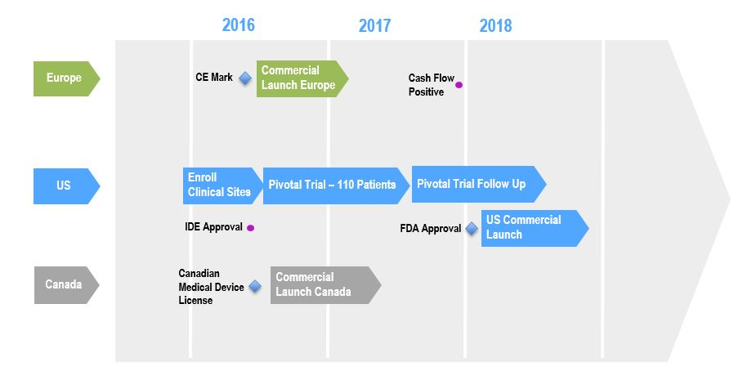
Solid Path to Commercialization
Notes:
This is the most current version of timelines

Slide 21

Recent & Upcoming Milestones
Received CE Mark approval in April 2016 for TULSA-PROTM
Sale of first TULSA-PROTM to ResoFus Alomar in Spain in April 2016
Granted IDE Approval from the FDA for Pivotal Trial
Pivotal Trial commencement
Expansion of strategic collaborations / distributor partnerships
Commercial launch Canada
Solidify reimbursement pathway

Slide 22
In Conclusion
TULSA poised to be a game changer in the clinical management of patients by ablation of targeted prostate tissue
Large and growing market opportunity; significant unmet medical need
Near- and mid-term milestones offer multiple value inflection opportunities
Technology well protected by strong IP portfolio
CE Mark obtained
Attractive razor/razor blade revenue model
Well established care delivery infrastructure
Proven leadership team
‘A GAME CHANGER’
In the clinical management
of prostate care

Slide 23
Capitalization
Exchange & Ticker TSXV: PRN
Cash (@ March 31, 2016) $16.9MM
Debt: FedDev $0.8MM
HTX $1.3MM
Knight $4.0MM
Common Shares (@ March 31, 2016)
Basic, Fully Diluted 39.5MM; 43.8MM
Significant Shareholders: BDC 24.8%
Genesys 23.1%
Knight 7.7%

Slide 24
TSXV: PRN
profoundmedical.com | 647-476-1350

