Slide 1
Heidelberg First Clinical Experience with Profound Medical Inc.’s MRI-Guided
TULSA-PRO
Ionel Valentin Popeneciu¹, Timur Kuru¹, Gencay Hatiboglu¹, Matthias Röthke², Maya Müller-Wolf², Joseph Chin³,
Michele Billia³, James Relle⁴, Jason Hafron⁴, Mathieu Burtnyk⁵, Heinz-Peter Schlemmer², Markus Hohenfellner¹, Sascha Pahernik¹
1. Department of Urology, University Hospital, Heidelberg, Germany
2. Department of Radiology, German Cancer Research Center (DKFZ), Heidelberg, Germany
3. Department of Urology, Western University (UWO), London Health Sciences Center, London Victoria Hospital, London ON, Canada
4. Department of Urology, Beaumont Health System, Royal Oak MI, United States
5. Profound Medical Inc., Toronto ON, Canada

Slide 2
MRI-GUIDED TULSA-PRO
Novel minimal-invasive treatment of localised prostate cancer
Main objectives:
  Improve ultrasound prostate ablation (e.g. HIFU) by
  Better treatment control
  MRI Thermometry = Dose
  Dose control = Focal
  Better safety profile (fewer side effects)
Ultimately: better cancer control with
better safety and preservation of quality of life
DKFZ Heidelberg, Universitätsklinik Heidelberg

Slide 3
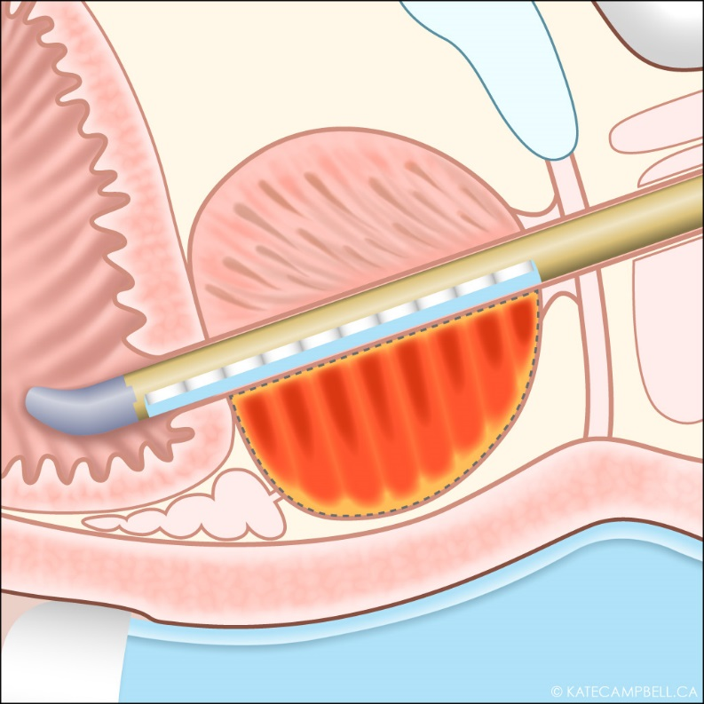
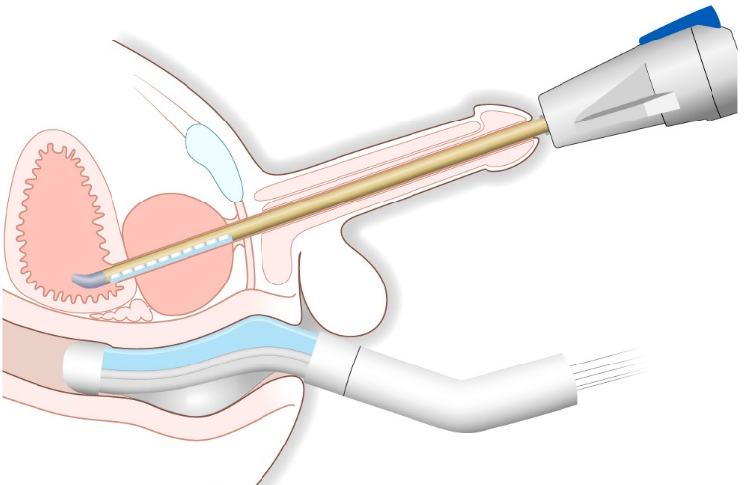
TULSA-PRO DEVICE
Transurethral Device
Prostate
Ultrasound Transducers
Bladder
Urethra
Heating Pattern
Thermal Ablation Boundary
Rectal Cooling Device
DKFZ Heidelberg, Universitätsklinik Heidelberg

Slide 4
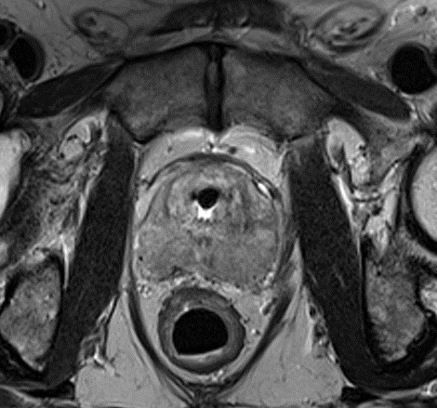

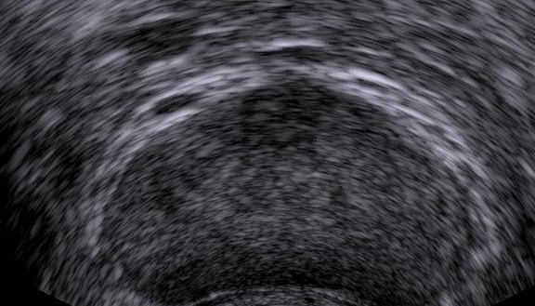
TULSA-PRO DIFFERENCE: ANATOMY
TULSA
HIFU
Transurethral
Source
Focal
Heating
Directional
Heating
Prostate
Increased
Rectal
Contact
Rectum
Transrectal
Source
DKFZ Heidelberg, Universitätsklinik Heidelberg

Slide 5
TULSA-PRO DIFFERENCE: TREATMENT
TULSA
HIFU
Discrete
Heating
(Outside-In)
Urethral
Cooling
Prostate
Rectum
Continuous
Heating
(Inside-Out)
DKFZ Heidelberg, Universitätsklinik Heidelberg

Slide 6
TULSA-PRO DIFFERENCE: IMAGING
TULSA
MRI-Guided
HIFU
Ultrasound-Guided
Soft tissue contrast
Quantitative thermometry
Temperature feedback control
Diagnostic
Limited accessibility
Widely accessible
Temporal resolution
Soft tissue contrast
Diagnostic
Qualitative feedback
DKFZ Heidelberg, Universitätsklinik Heidelberg
Notes:
MRI provides high-resolution, soft-tissue-contrast images enabling precise localization and placement of devices, as well as target prostate boundary delineation. Soft-tissue-contrast images permit the precise identification and delineation of the prostate and surrounding anatomy, allowing the application of sophisticated treatment planning strategies to enhance treatment delivery on a patient-specific basis. To date, MRI offers the most accurate modality to image and define the prostate.
MRI thermometry provides non-invasive, quantitative, spatial and temporal temperature measurements, enabling active feedback control to compensate for inter- and intra-patient tissue variability, biophysical tissue changes during treatment, and to ensure adequate and accurate heating of the target volume.
MRI can also detect and localize cancer within the prostate [Langer et al 2009], offering diagnostic images which could be incorporated seamlessly in the planning of prostate cancer treatments, without the need for image registration between the diagnostic, soft-tissue contrast and temperature feedback images.

Slide 7
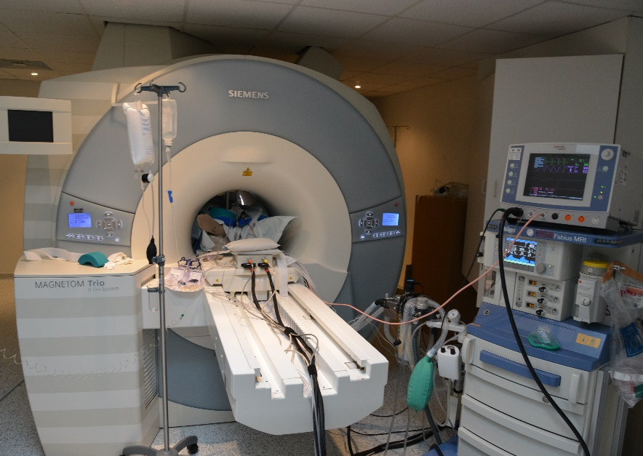

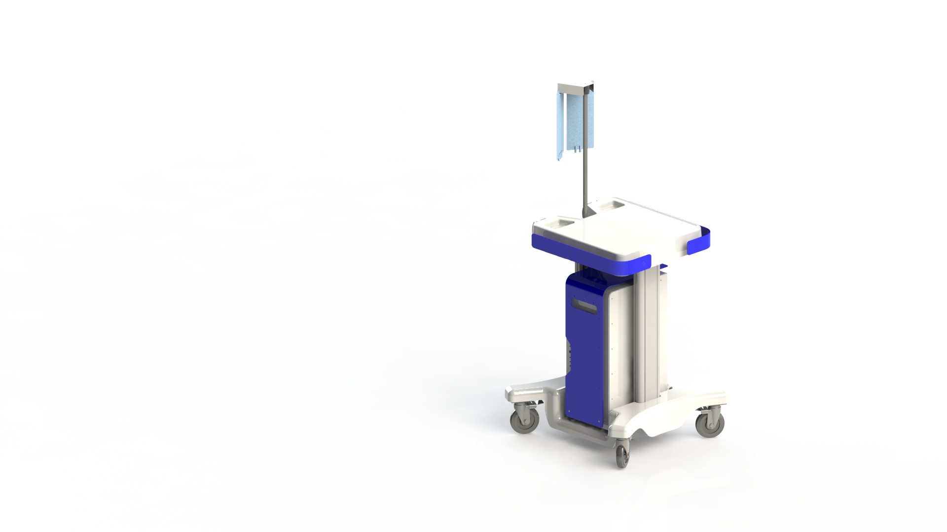
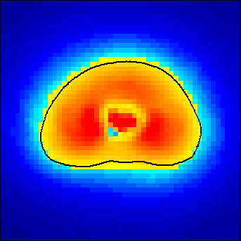
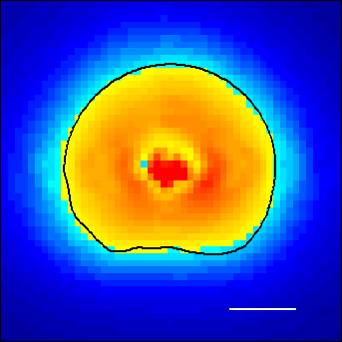
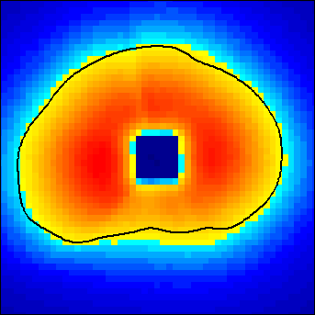
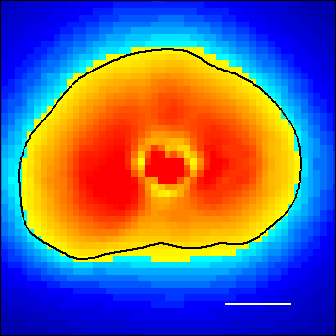
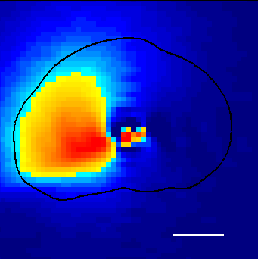
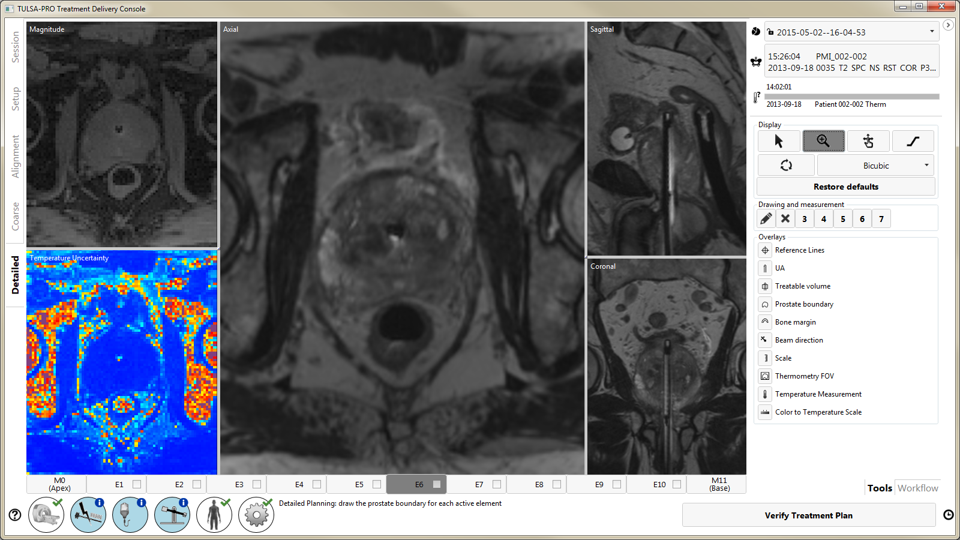
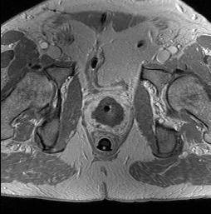
MRI-GUIDANCE
1
3
MRI Thermometry Acquisition
Adjust Power,
Frequency,
Rotation Rate
2
Temperature
Feedback
Control
1 cm
Device
Positioning
CE-MRI
Verification
Planning
Treatment
40 min
Precise Treatment Planning
Visualization of NPV
DKFZ Heidelberg, Universitätsklinik Heidelberg

Slide 8
PHASE I STUDY DESIGN
Study Design
Prospective, multi-center, single-arm
Inclusion Criteria
Age ≥ 65 years
Low-/intermediate-risk prostate cancer
  Biopsy confirmed organ-confined prostate cancer: cT1c or T2a, N0, M0
  PSA ≤ 10 ng/ml
  Gleason score 3+3 (Germany/USA), ≤ 3+4 (Canada)
No prior prostate cancer treatment
Endpoints
Primary: Safety (adverse events) and Feasibility (precise heating), 1-year follow-up
Exploratory: Efficacy (PSA and Biopsy) and QoL (patient questionnaire), 5-year follow-up
DKFZ Heidelberg, Universitätsklinik Heidelberg
Notes:
Safety: Frequency and severity of treatment related adverse events (NCI CTCAE v4)
Feasibility: Accurate and precise heating of the prostate (quantitative on MR thermometry and qualitative on CE-MRI)
Efficacy: PSA response and biopsies at 1 and 3 years
QoL: IPSS, IIEF, Bowel function domain of UCLA-PCI-SF

Slide 9
PATIENT RECRUITMENT
Recruitment: Entire Study
30 patients enrolled: March 2013 – March 2014
Clinical trial sites in 3 jurisdictions, all under same protocol
  Urology / DKFZ (Heidelberg, Germany): 14 patients
  Western University (London ON, Canada): 12 patients
  William Beaumont Hospital (Royal Oak MI, United States): 4 patients
Screening: Heidelberg – 82 Patients
N = 47 Active Surveillance (57.3%)
N = 14 TULSA-PRO (17.1%)
N = 11 Radical DaVinci Px (13.4%)
N = 6 Radiotherapy (7.3%)
N = 4 “Wait and see” (4.9%)
DKFZ Heidelberg, Universitätsklinik Heidelberg

Slide 10
PATIENT PREPARATION
General Anesthesia
GI anti-spasmodic drug
  Eliminate peristaltic motion of the colon which can cause artifacts on MRI thermometry
Supra-Pubic Catheter (SPC)
  Drains bladder prior and during treatment
  Eliminate filling of bladder after treatment planning and during treatment
  Removal at 2-week follow-up visit after treatment
Guidewire
  Aid insertion of transurethral device
DKFZ Heidelberg, Universitätsklinik Heidelberg

Slide 11
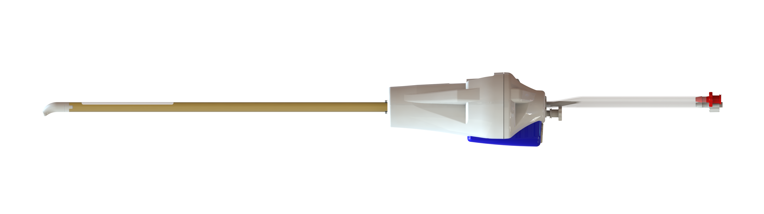
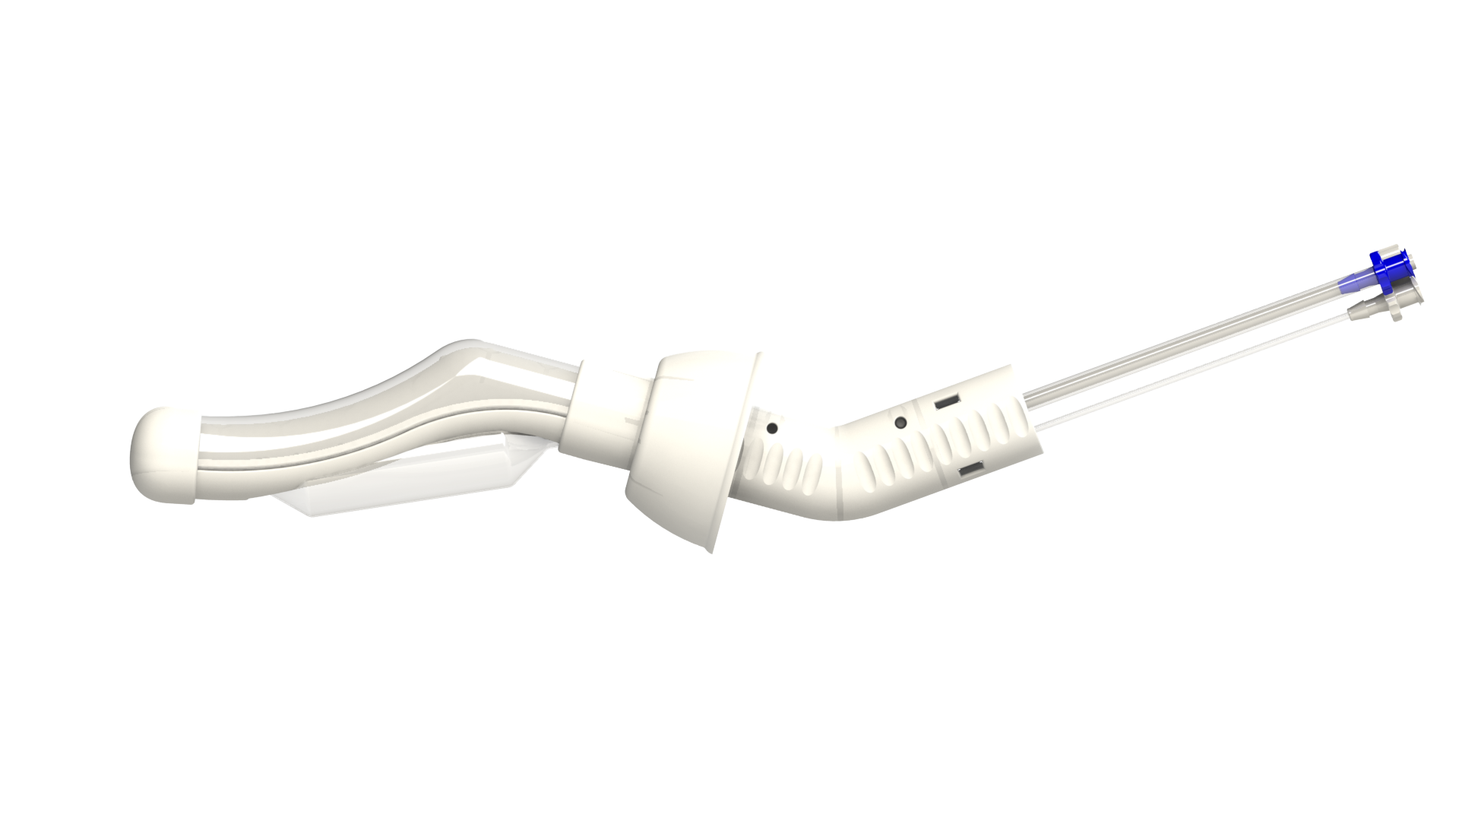
TULSA-PRO DEVICES
Urethral Device
10 independent ultrasound transducer elements; 4 & 13 MHz; 0 to 4 W acoustic / element
Rigid catheter; Size 22 French; Sterile, single-use, disposable
Rectal Cooling Device
Passive cooling; Non-sterile, single-use, disposable
DKFZ Heidelberg, Universitätsklinik Heidelberg

Slide 12
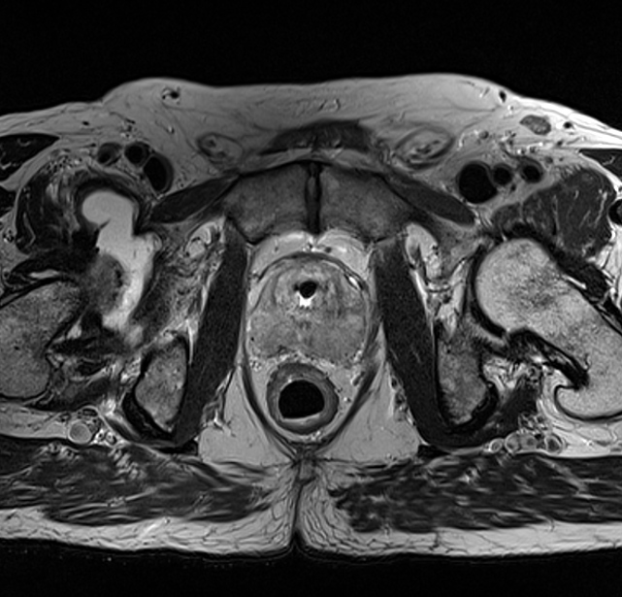
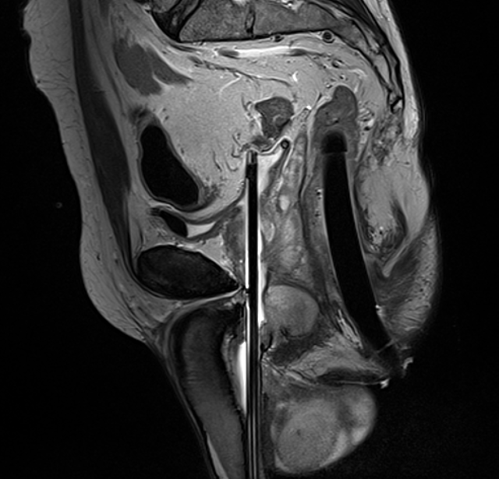
MRI-GUIDED DEVICE POSITIONING
Axial T2w MRI
Sagittal T2w MRI
Transurethral
Device
Rectal
Cooling
Device
Transurethral
Device
Rectal
Cooling
Device
DKFZ Heidelberg, Universitätsklinik Heidelberg

Slide 13
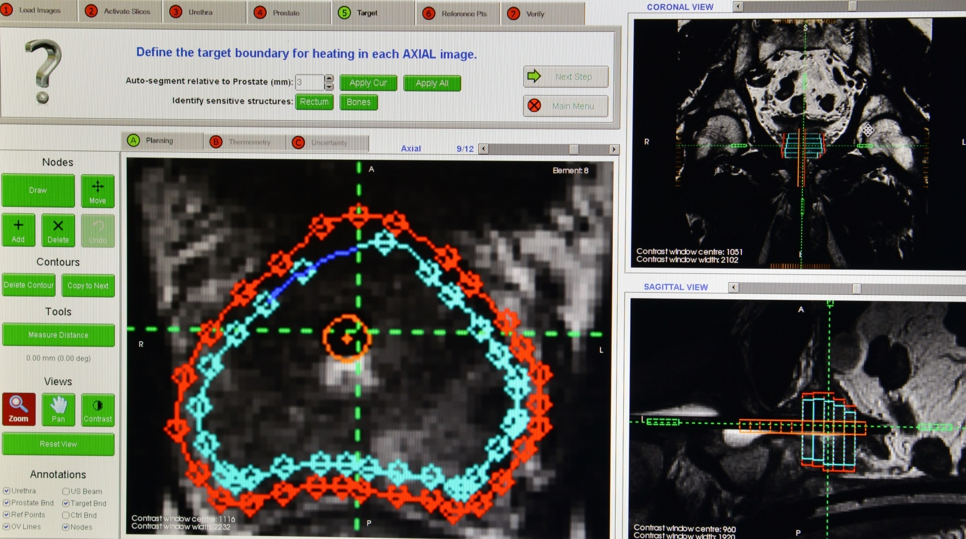
PHASE I TREATMENT PLANNING
Conservative whole-gland treatment planning
3 mm safety margins at capsule and apex
10% residual viable tissue expected at periphery
DKFZ Heidelberg, Universitätsklinik Heidelberg
Notes:
Incidence: death rate 14:1.

Slide 14
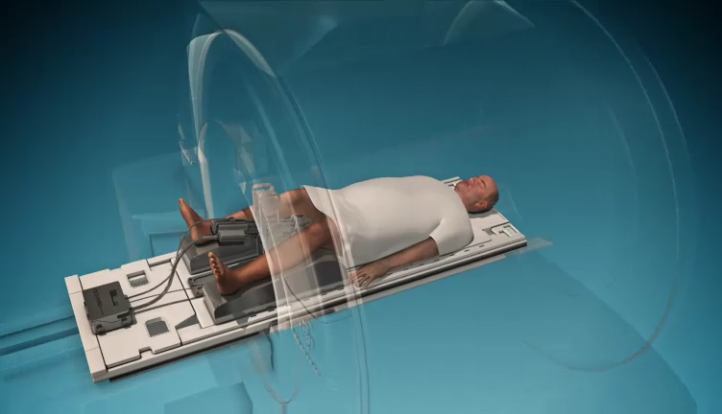
MRI-GUIDED TREATMENT
DKFZ Heidelberg, Universitätsklinik Heidelberg

Slide 15
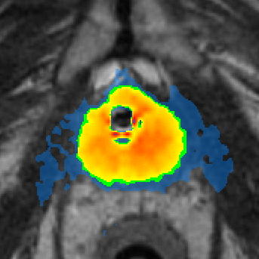
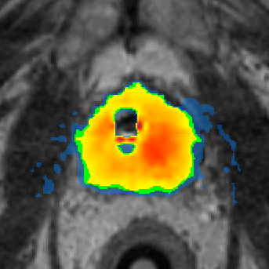
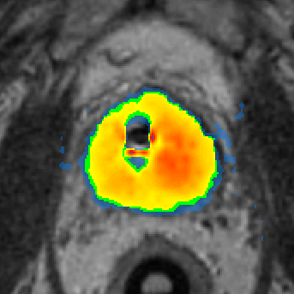
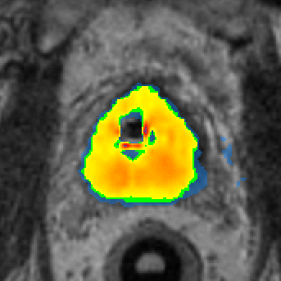
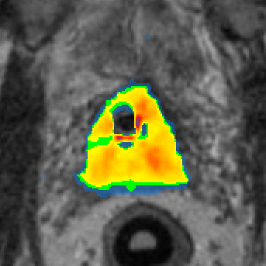
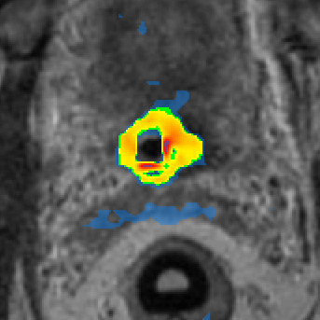
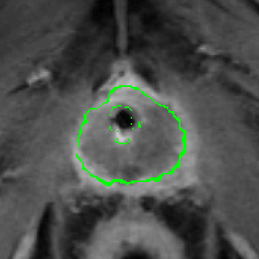
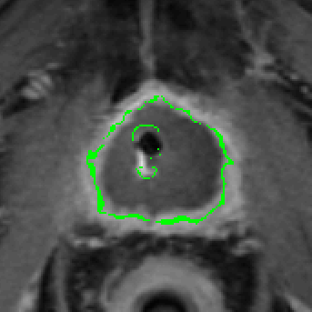
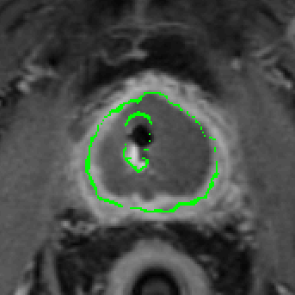
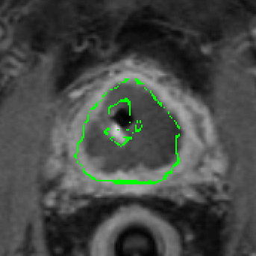
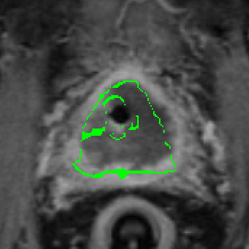
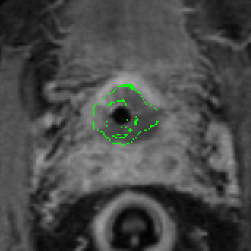
TREATMENT ASSESSMENT
Maximum Temperature > 43°C on T2w planning MRI:
Apex
Base
1cm
Maximum Temperature (˚C)
Maximum Temperature 52-55°C on acute post-treatment CE-MRI:
43
50
60
70
80
90
Apex
Sub-lethal
Acute cell kill
Base
Late cell kill
1cm
Pre-clinical trials: “acute cell kill” zone = contrast enhancement zone in the periphery of non-perfused volume (NPV)
DKFZ Heidelberg, Universitätsklinik Heidelberg
Notes:
Treatment is tailored to patient-specific tissue (dynamic vascularity, stromal epithelial ratio)
Homogeneous and conformal Non Perfused Volume (NPV) on acute CE-MRI matches cell kill
on MRI thermometry and confirms ablation of the target tissue volume

Slide 16
TEMPERATURE CONTROL
 | PARAMETER | AVERAGE (n=30) | 95% CI (n=30) | RANGE (n=30)
 | Prostate Volume (cc) | 47 cc | 41 – 54 | 21 – 95
 | Treatment Time (min) | 36 min | 32 – 40 | 24 – 61
Linear | Targeting Accuracy (mm) | 0.1 mm | -0.1 – 0.2 | -0.6 – 1.1
 | Targeting Precision (mm) | 1.3 mm | 1.2 – 1.5 | 0.7 – 2.4
Volume | Over-Targeted Volume (cc) | 0.8 cc | 0.6 – 1.0 | 0.1 – 2.6
 | Under-Targeted Volume (cc) | 1.0 cc | 0.6 – 1.4 | 0.0 – 4.8
 | Dice Similarity Coefficient (DSC) | 0.94 | 0.93 – 0.94 | 0.91 – 0.96
DKFZ Heidelberg, Universitätsklinik Heidelberg
Notes:
Accurate and precise temperature control was achieved in all 30 patients
Targeting Accuracy: Spatial difference between planned target tissue and 55°C cell kill (thermometry)

Slide 17
SAFETY OVERVIEW
No intraoperative complications
No rectal injury or fistula
No severe urinary incontinence
No Grade 4 or higher adverse events
Total of one attributable Grade 3 adverse event
(epididymitis resolved with IV antibiotics)
Majority are acute Grade 1 and 2 events related to GU system
Estimated ED rate of 8% (IIEF item 2 ≥ 2)
Planned overnight in hospital and discharged next day
DKFZ Heidelberg, Universitätsklinik Heidelberg
Notes:
Grade 3 event was GU infection, epididymitis resolved with IV anti-biotics
Estimated ED rate of 8% based on IIEF item 2, erection firmness sufficient for penetration
Majority of events are acute, meaning occurred and resolved within 3 months of treatment

Slide 18
ADVERSE EVENTS*
Hematuria Grade 1 (13 patients) and G2 (2 patients), resolved
Infections:
  Urinary Tract Infection: G2 (10 patients), resolved with no action (1) or oral antibiotics (9)
  Epididymitis: G3 (1 patient), resolved with IV-antibiotics
Urinary retention:
  G1 (3 patients) resolved spontaneously, repositioning SPC tubing or SPC irrigation
  G2 (5 patients), resolved with medication (1) or prolonged-/re-catheterization (4)
Urinary or urge incontinence:
  G1 (1 patient), resolved with no action
  G2 (3 patients), resolved with no action (1), resolved with medication (1), and ongoing (1)
  though downgraded to G1 and not using pads
All GI-related events:
  Bloating: G1 (3 patients), resolved with no action (may be due to anti-spasmodic drug)
  Fecal straining: G1 (1 patient), resolved with no action after 7 days
  Rectal pain: G1 (1 patient), resolved with no action after 1 day
DKFZ Heidelberg, Universitätsklinik Heidelberg
* Related or possibly related adverse events: all G3 events shown, most severe/frequent G2 events shown, and select G1 events shown.
Multiple of the same event are recorded once per patient using the highest grade.
Notes:
Urinary retention grade 1 related to SPC
At 12-months, there is a total of 1/30 patients (3.3%) with ongoing grade 1 urinary incontinence, occasional with coughing and sneezing and not using pads.

Slide 19

URINARY SYMPTOMS
Box: 25% / Median / 75%
Whiskers: Min / Max within 1.5 IQR
Squares: Average
Circles: Outliers
Severe Symptoms
Moderate
Mild
DKFZ Heidelberg, Universitätsklinik Heidelberg

Slide 20

UROFLOWMETRY
Box: 25% / Median / 75%
Whiskers: Min / Max within 1.5 IQR
Squares: Average
Circles: Outliers
DKFZ Heidelberg, Universitätsklinik Heidelberg

Slide 21
ERECTILE FUNCTION
No ED
Box: 25% / Median / 75%
Whiskers: Min / Max within 1.5 IQR
Squares: Average
Circles: Outliers
Mild
Mild to
Moderate
Moderate
Severe
DKFZ Heidelberg, Universitätsklinik Heidelberg

Slide 22
BOWEL HABITS
Box: 25% / Median / 75%
Whiskers: Min / Max within 1.5 IQR
Squares: Average
Circles: Outliers
DKFZ Heidelberg, Universitätsklinik Heidelberg

Slide 23
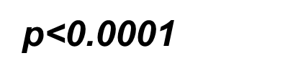
ABLATION EFFICACY
Box: 25% / Median / 75%
Whiskers: Min / Max within 1.5 IQR
Squares: Average
Circles: Outliers
DKFZ Heidelberg, Universitätsklinik Heidelberg
Notes:
Median PSA decreased by 87% to 0.75 ng/ml at 1 month (n=30) and remained stable at 0.80 ng/ml at 12 months (n=30).
Median and average PSA nadir to-date are 0.60 and 0.69 ng/ml, respectively (n=30).

Slide 24
BIOPSY RESULTS AT 12 MONTHS
Phase I treatment parameters were conservative
  First-in-human study as primary treatment for prostate cancer
  Lethal thermal dose -0.7 ± 1.2 mm inside prostate
  10% viable prostate expected at prostate periphery
MRI & TRUS biopsy show diminutive prostate volumes averaging 51% fibrosis (N=29)
Positive biopsies demonstrate 61% reduction
in total cancer length (reduced cancer burden)
Positive biopsies –
Clinically significant disease: 31% patients
Any disease: 55% patients
Patient status
  27 patients in active surveillance, no further treatment to date
  3 patients opted for active treatment (RPx, histology pending)
Phase I Treatment Parameters
DKFZ Heidelberg, Universitätsklinik Heidelberg

Slide 25
WHAT’S NEXT ?
Pivotal clinical trial being initiated in larger prostate cancer population
Reduced safety margin for complete whole-gland ablation
Phase I Parameters
Pivotal Trial Parameters
DKFZ Heidelberg, Universitätsklinik Heidelberg

Slide 26
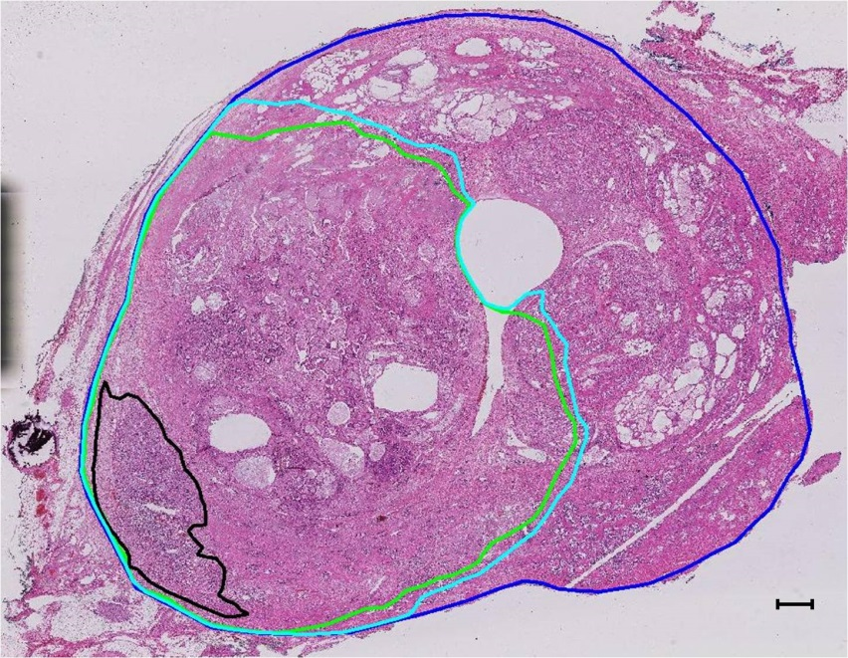

CLINICAL HISTOLOGY
Acute H&E Histology
Dr. Laurence Klotz, Dr. Masoom Haider & Dr. Rajiv Chopra at Sunnybrook Research Institute (Toronto ON, Canada)
Second Phase 0 “Treat & Resect” study
Targeted MRI-visible cancer for ablation, with pivotal trial treatment parameters
Demonstrated complete cell kill (coagulative necrosis) to prostate boundary on acute H&E histology
Prostate Boundary
Acute Coagulative Necrosis
Outer Limit of Thermal Injury
Tumour
* Courtesy Rajiv Chopra
Chopra et al. “Clinical Evaluation of Transurethral MR-HIFU for the Treatment of Localized Prostate Cancer,” ISMRM Annual Meeting 2014 (Milan, Italy)
DKFZ Heidelberg, Universitätsklinik Heidelberg

Slide 27
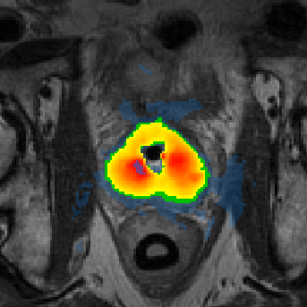
CONCLUSIONS
First Experience with TULSA-PRO
Clinically Feasible
Low toxicity & Good safety profile
Ambulatory procedure
Suitable to focal treatment
  No MRI/TRUS fusion errors
What’s next?
Phase I follow-up to 5 years
Pivotal trial to commence in 2016
Endpoints: ablation efficacy, safety & biopsy
  Reduced safety margins for complete whole-gland ablation
  Diagnostic multi-parametric MRI
DKFZ Heidelberg, Universitätsklinik Heidelberg

